Slide 1
Rethinking our architecture with Platform Events
Florian Hoehn, Technical Architect, Mavens
@florianhoehn

Slide 2



Florian Hoehn
Florian Hoehn
Technical Architect at Mavens
florianhoehn

Slide 3
From CRM to Enterprise…

Slide 4
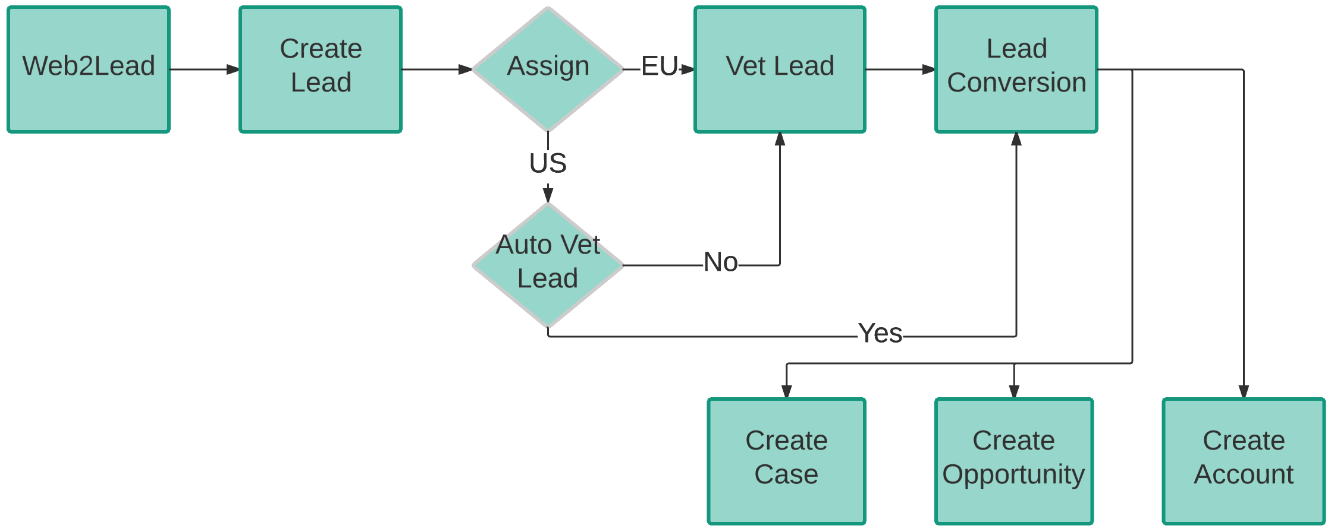
Processes change
CRM

Slide 5
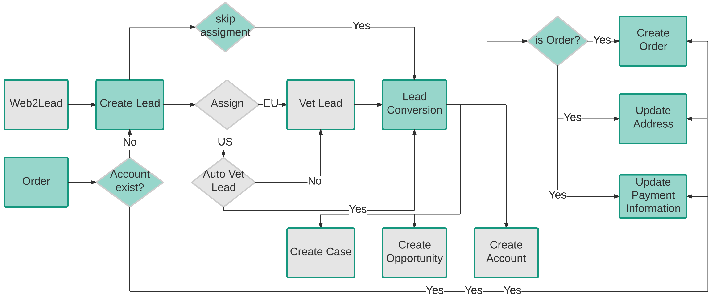
Processes change
CRM & Order Management

Slide 6
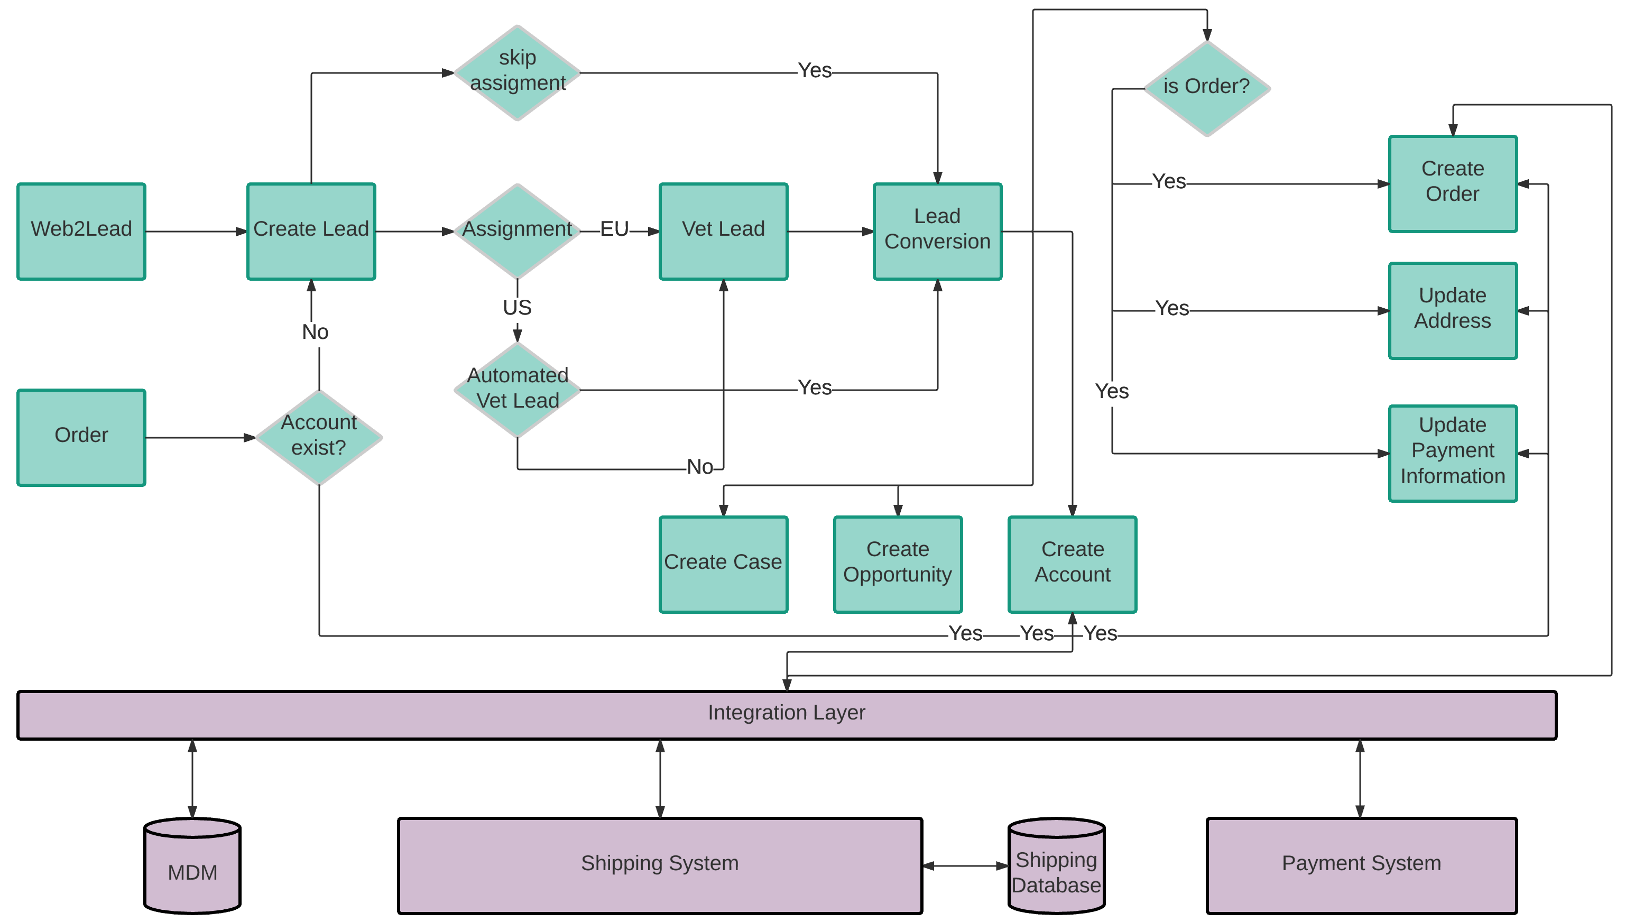
Processes change
Systems Architecture

Slide 7
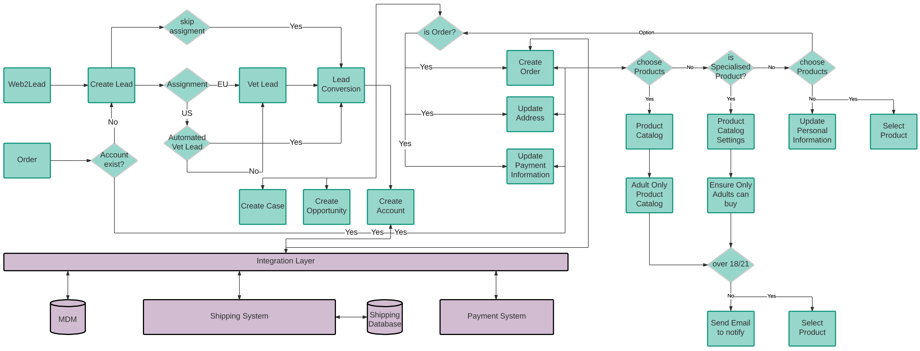
Processes change
Adding complexity with every feature

Slide 8
This is not scalable!

Slide 9
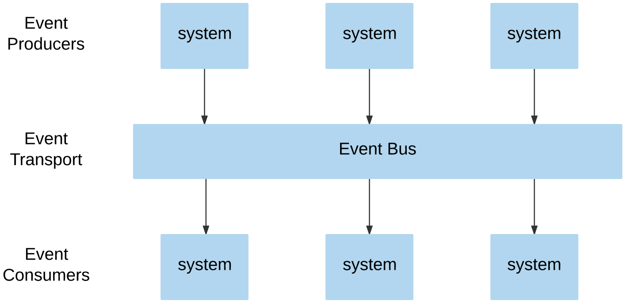
Platform Events
How can platform events help us?

Slide 10
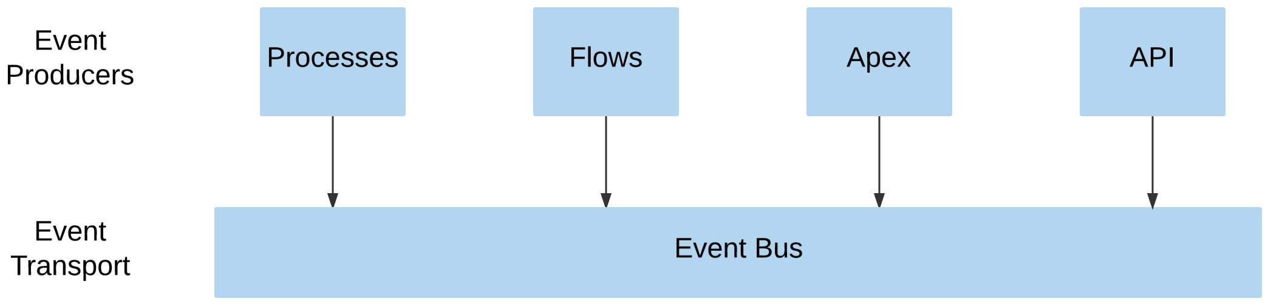
Platform Events
Publishing

Slide 11
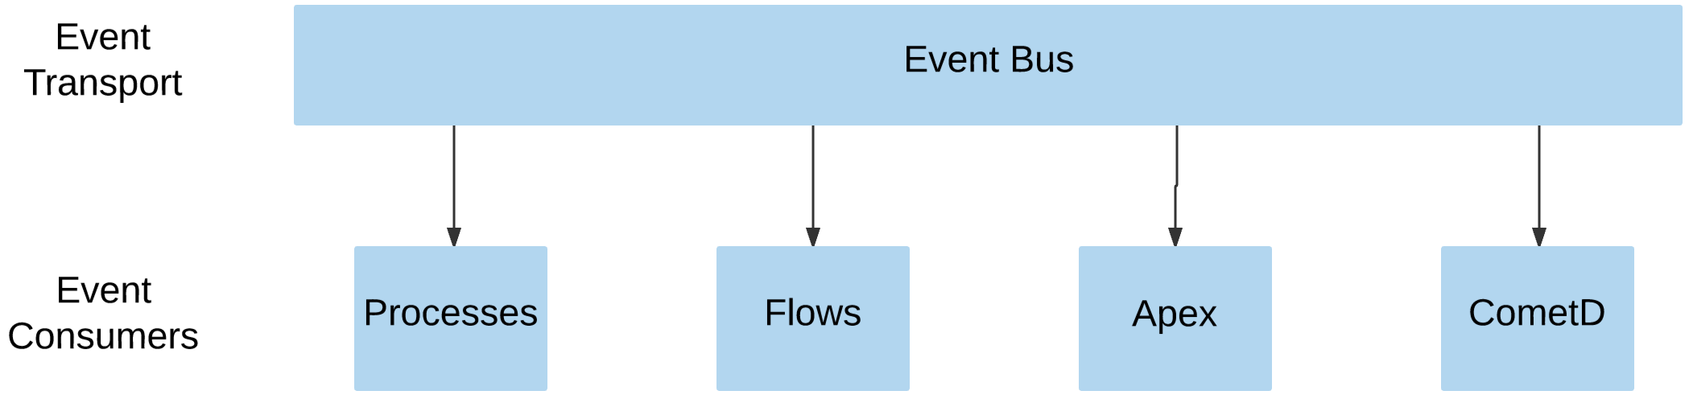
Platform Events
Subscribing

Slide 12
How do Platform Events help us with our architecture?
Separate all those concerns of yours

Slide 13
How do Platform Events help us with our architecture?
Separate all those concerns of yours

Slide 14
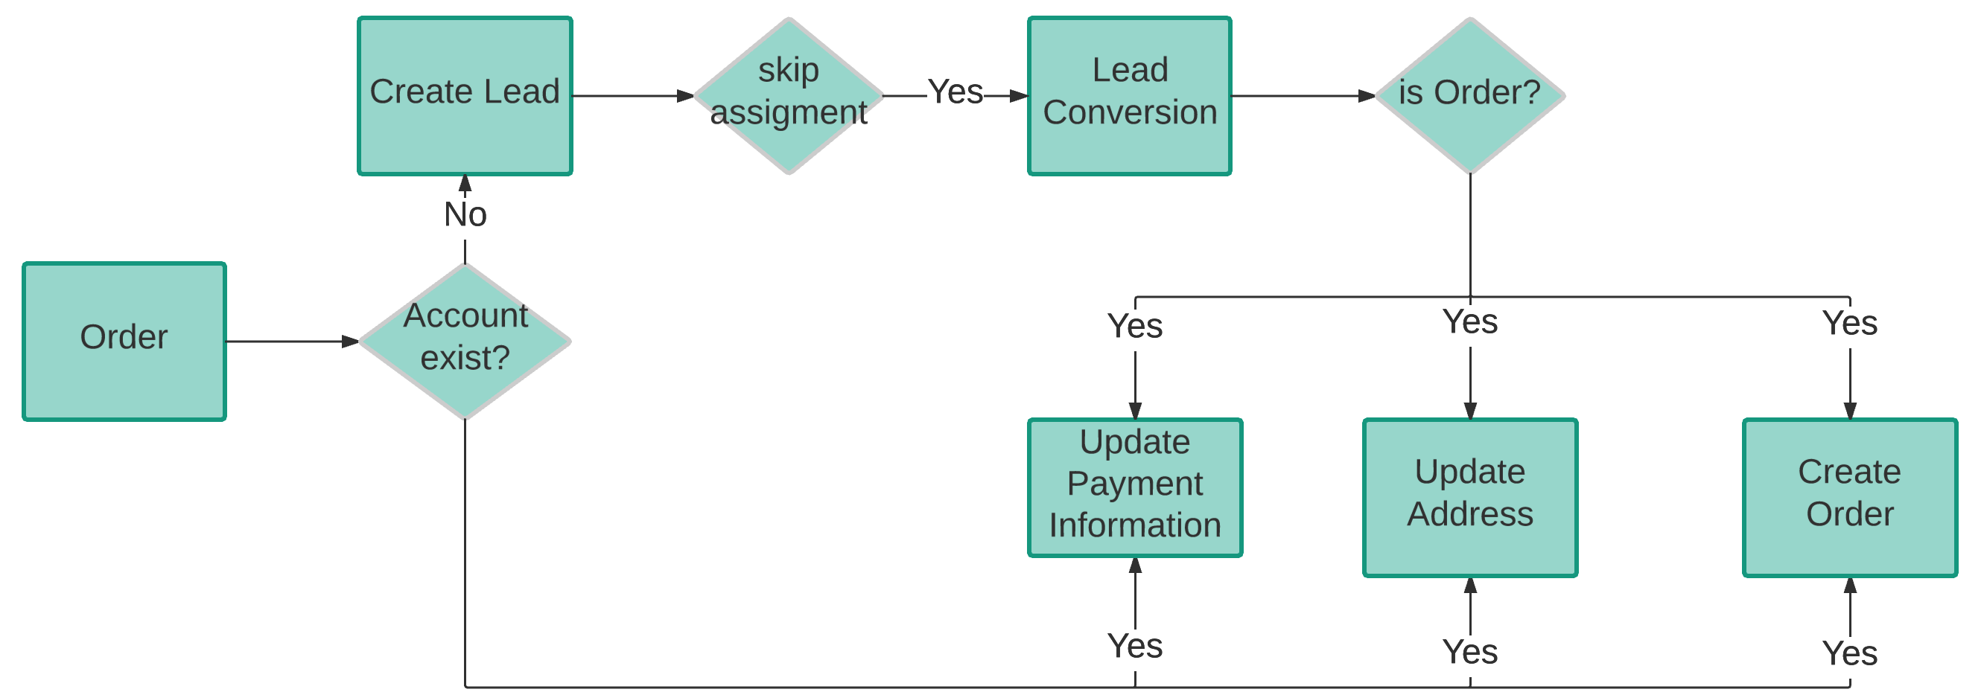
How do Platform Events help us with our architecture?
Separate all those concerns of yours

Slide 15
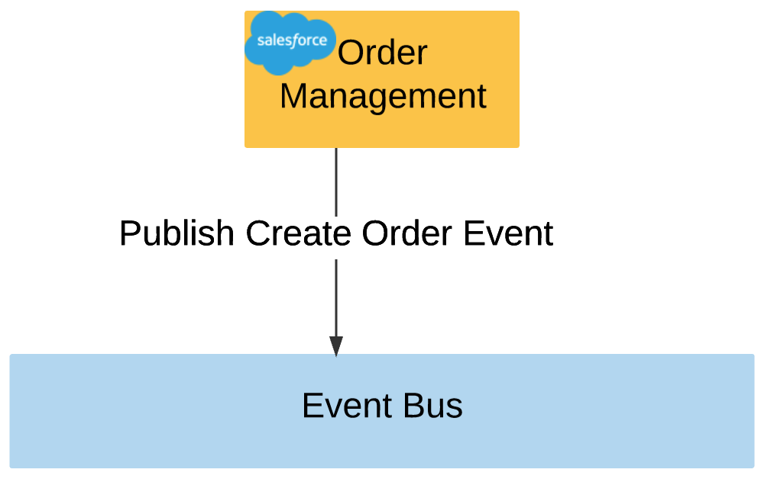
How do Platform Events help us with our architecture?
Separate all those concerns of yours
Publishing Create Order Event
The order management module does not know which other systems react on the Create Order Event.
→ no dependencies

Slide 16
Platform Event Use Cases

Slide 17
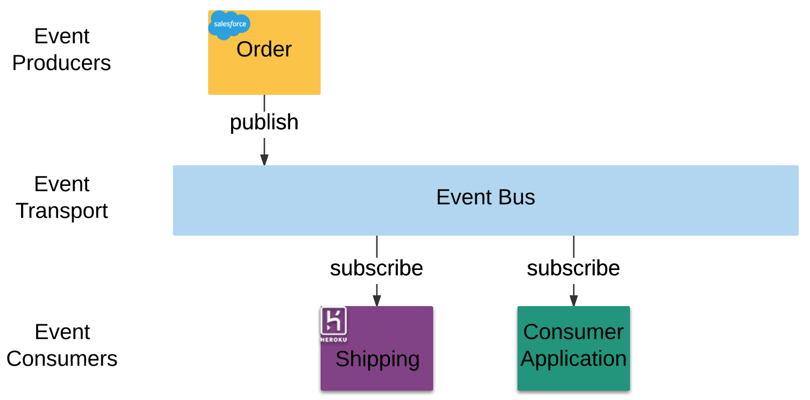
Using Platform Events for integrations

Slide 18
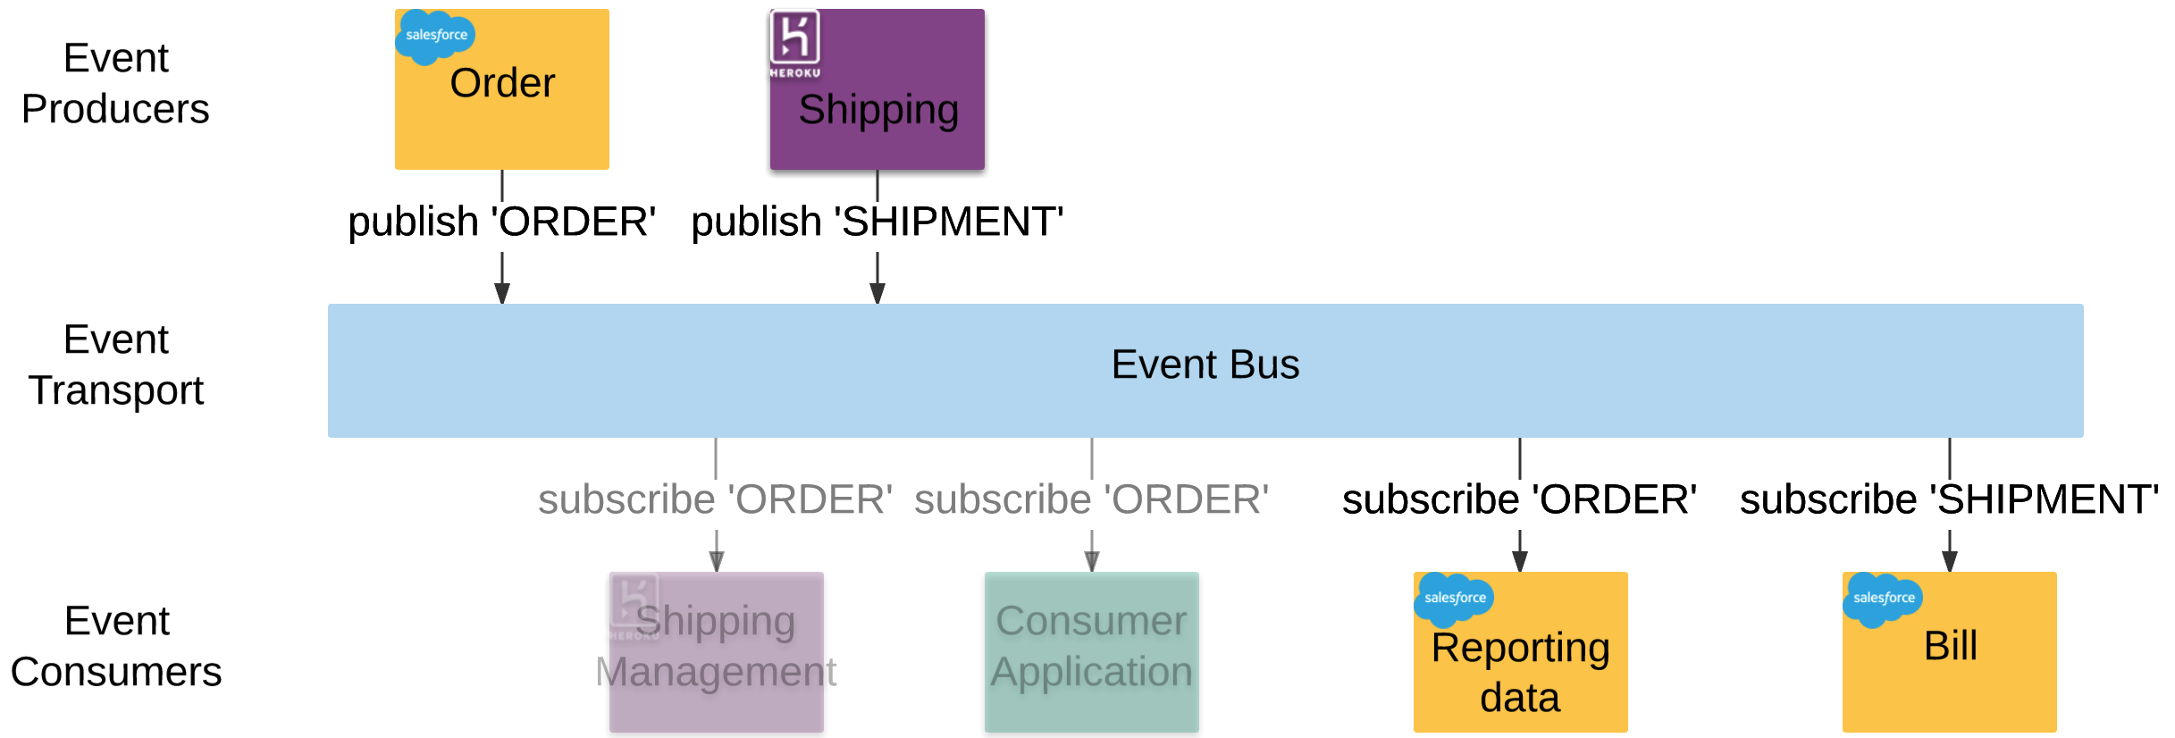
Using Platform Events on the platform

Slide 19
Using native Platform Events
The future might be bright…
What if we have access to Salesforce Standard Events like
- Lead Conversion
- Escalation rules on cases fired
- Change Data Capture (Pilot)
What if we have a Event Sourced Platform?

Slide 20
Event Sourcing
Event Sourcing is an architectural pattern in which the state of the application is being determined by a sequence of events

Slide 21
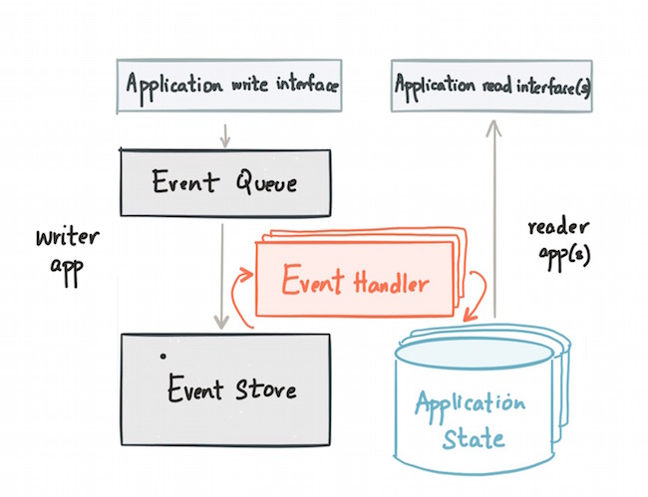
Event Sourcing

Slide 22
Our new system architecture

Slide 23
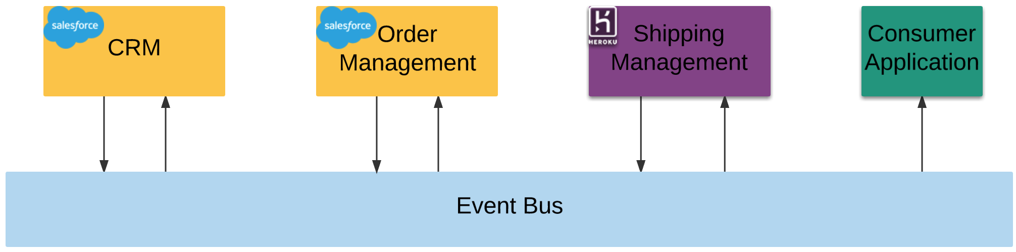
Processes still change
… but we are ready for it!

Slide 24
Great! Now let’s throw away all our architecture…

Slide 25
Our Reality

Slide 26
Our Goal

Slide 27
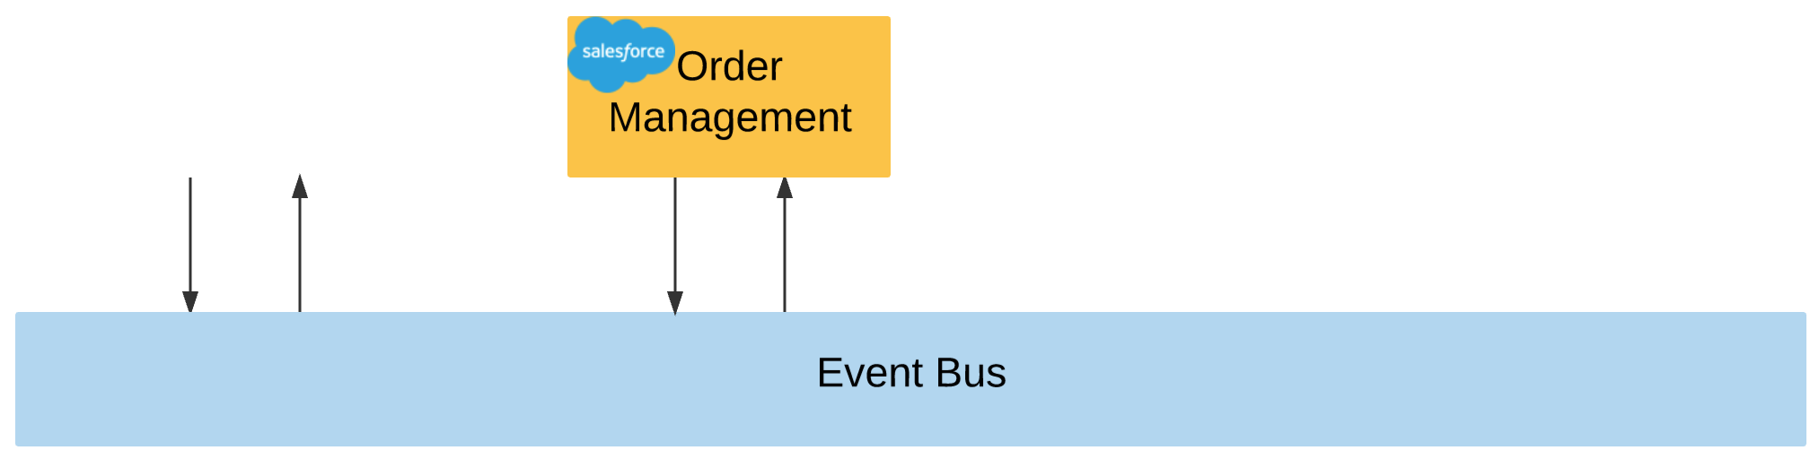

A possible first step

Slide 28

Plays well with DX
Salesforce DX

Slide 29
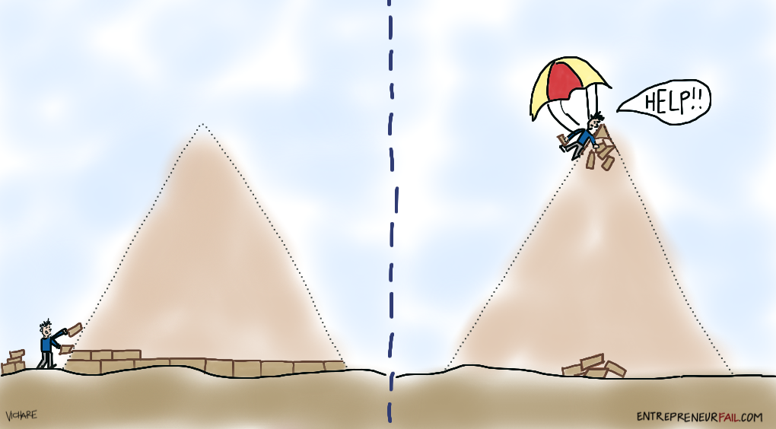
Little by little

Slide 31


Resources
florianhoehn
Slides and all information available on github:
https://github.com/florianhoehn/platform-events-architecture
https://trailhead.salesforce.com/modules/platform_events_basics
https://developer.salesforce.com/docs/atlas.en-us.platform_events.meta/platform_events/platform_events_intro.htm

